Slide 1
Towards a better coordination and harmonization of the Arctic Research Vessel fleet
21st ERVO Annual Meeting, Hamburg, 11-13 June 2019
Verónica Willmott, AWI

Slide 2
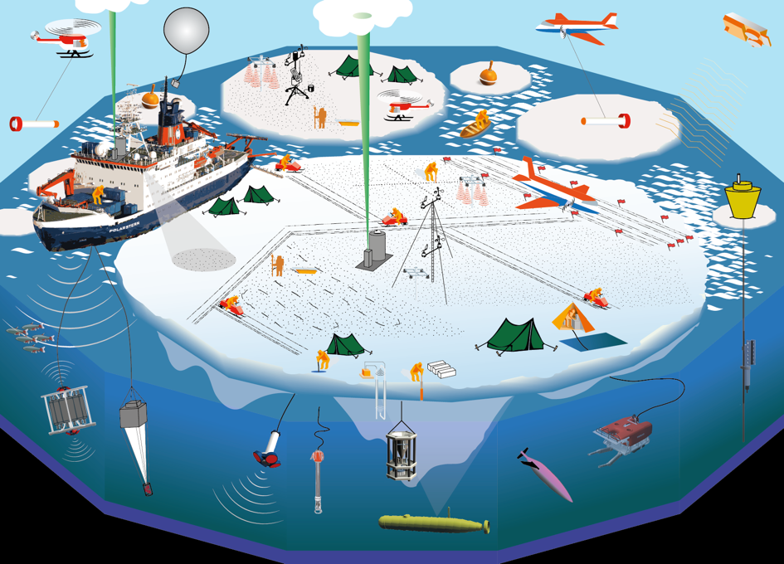
Data needs: i.e. to improve weather and sea ice forecast
Notes:
There is, without doubt, a need for data collection in the Arctic Ocean. Several international intitiatives are currently planned, some of them include the coordination of several icebreakers. Those intitiatives will contribute towards data collection, but those are punctual actions, not sustained in time. There is a need for sustained coordination of icebreakers and data collection in the Arctic.

Slide 3
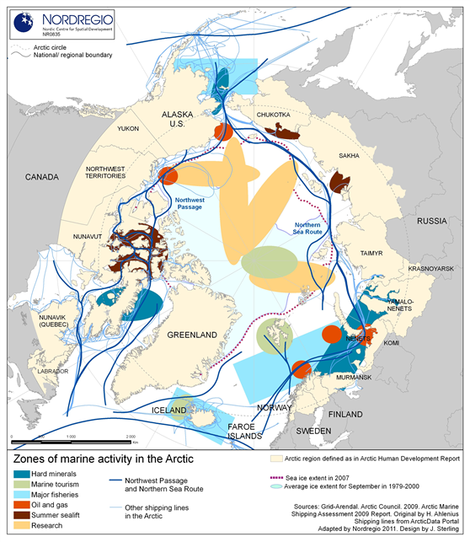
Increase in marine activity
Notes:
Without icebreakers, researchers could not do research during some of the most biologically productive times in the Arctic. No icebreakers would limit availability of scientifically important data necessary for accurate environmental assessments in resource development planning.

Slide 4
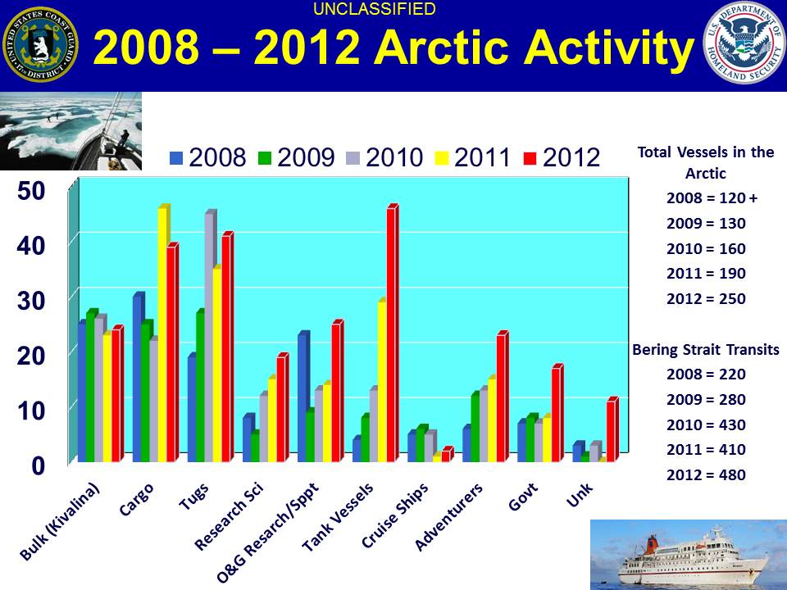
Increase in traffic in the Arctic Ocean
The Healy rescues a Russian tanker stuck in ice near Nome, Alaska, in January 2012. Icebreakers are necessary for such rescues and will become increasingly important as the polar regions open to more maritime traffic. Credit: U.S. Coast Guard photo by Petty Officer 1st Class Sara Francis.
Notes:
As the ice has melted, previously nonexistent travel lanes have opened in the summer, which has led to increased traffic in the Arctic — including tourist traffic, which is expected to rise with further ice retreat — along with maritime shipping, scientific research, and oil and gas development.
As we move forward with such development, the need for icebreaker support in the Arctic becomes more pressing.
A lack of icebreakers means no rescue for fishermen, tourists or scientists stranded in heavy ice. Icebreakers are intrinsic to commerce, security and the future of polar science.

Slide 5
ARICE project – Main Goal
To provide Europe with better capacities for marine-based research in the ice-covered Arctic Ocean by:
better coordinating the existing polar research fleet,
offering transnational access to a set of international High Arctic research icebreakers,
collaborating with maritime industry in a “programme of ships and platforms of opportunity”.

Slide 6
ARICE partners
16 partners from 13 different countries

Slide 7
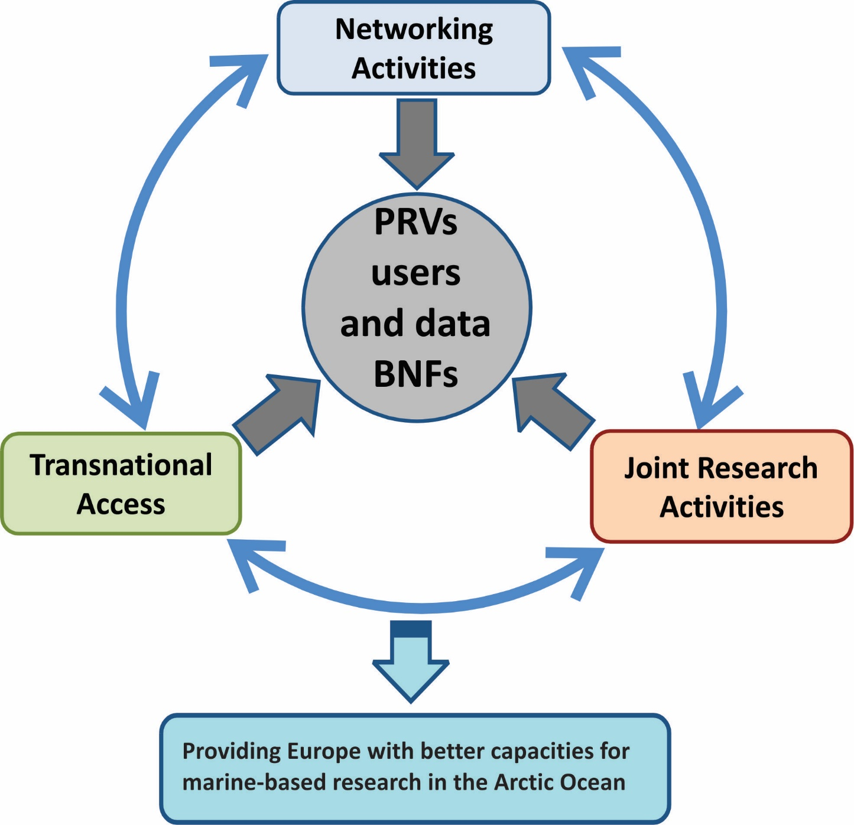
ARICE project - Pillars

Slide 8
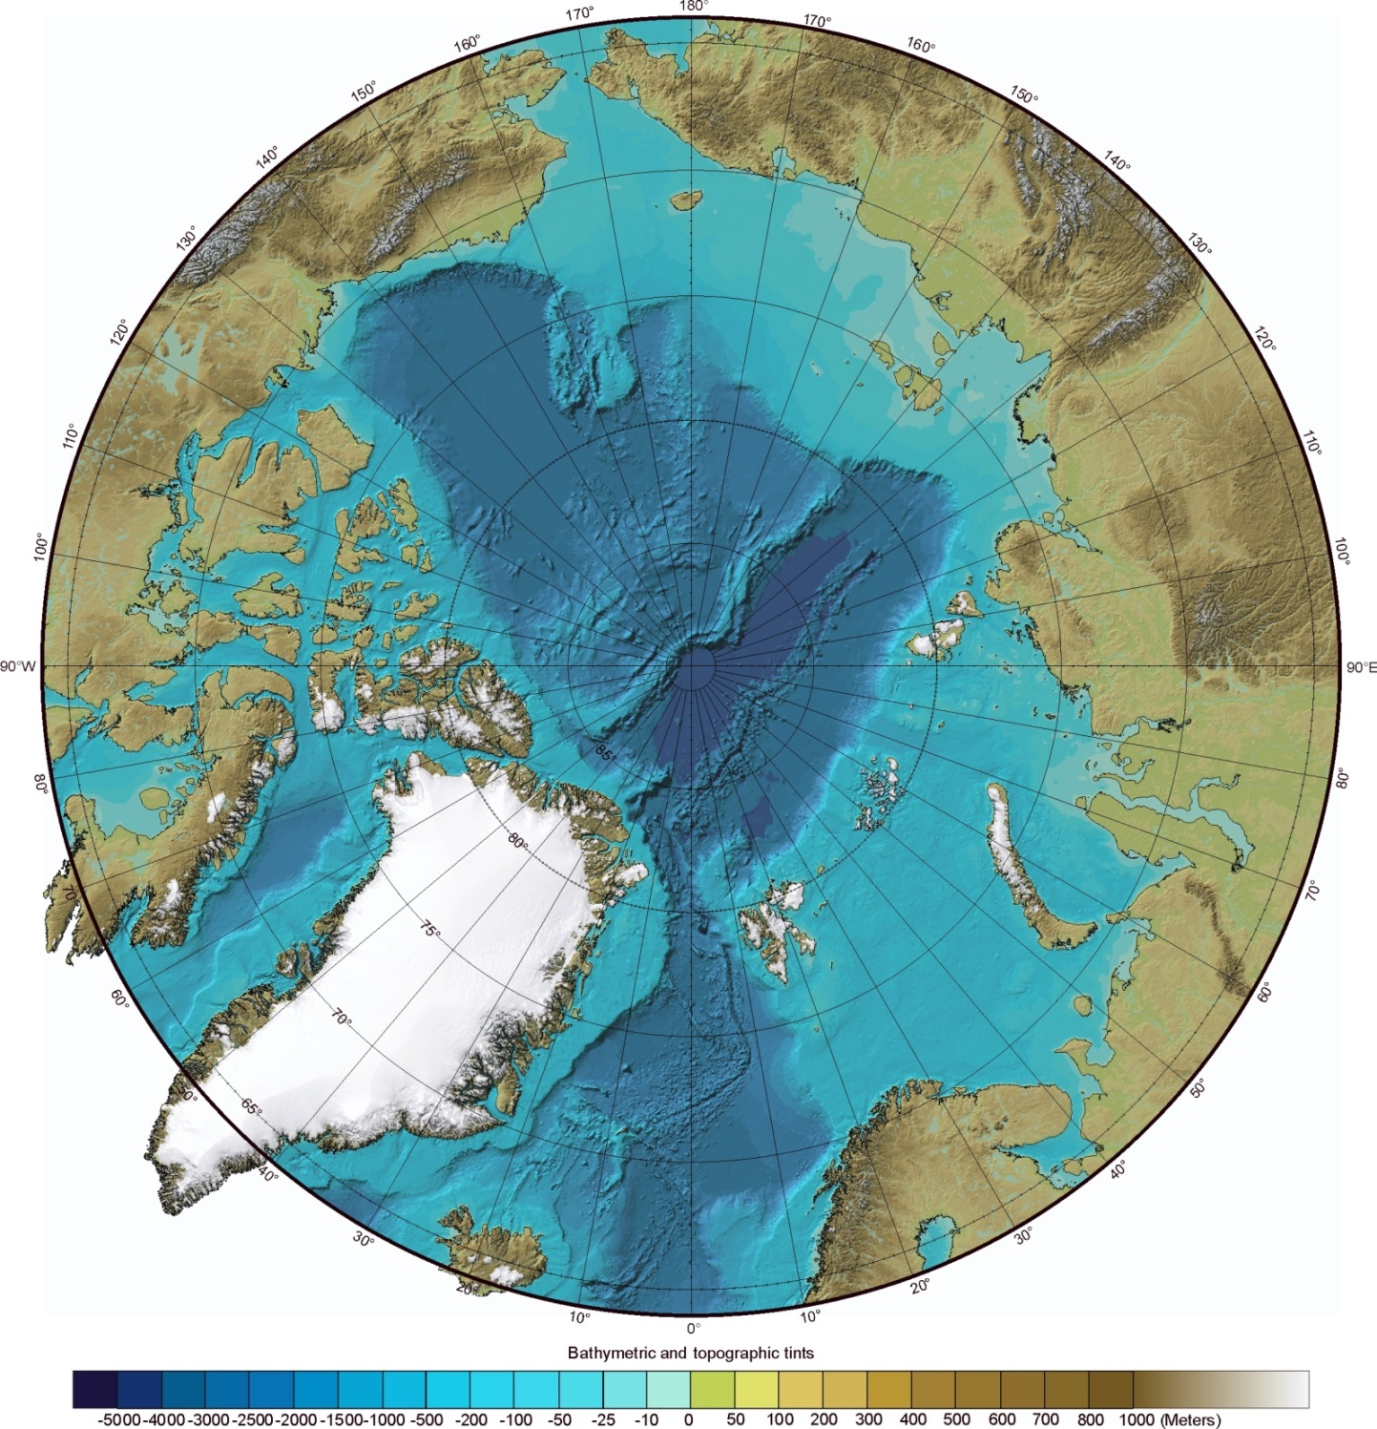
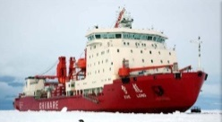
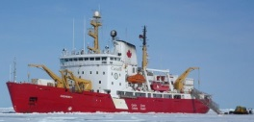
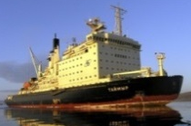
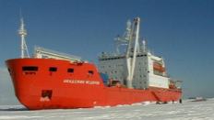
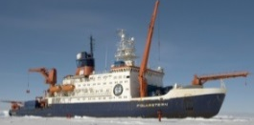
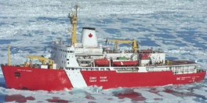
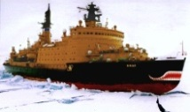
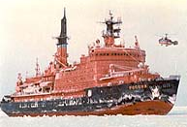
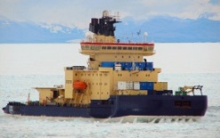
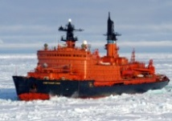
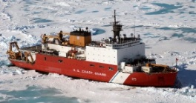
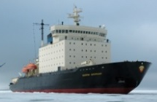
Heavy icebreakers in the Arctic
Xué Lóng
Araon
CCGS Amundsen
Taymyr
Akademik Fyodorov
Polarstern
CCGS Louis S. St-Laurent
Yamal
Rossiya
Oden
USCGC Healy
Sovetskiy Soyuz
Kapitan Dranitsyn
Kronprins Haakon
Notes:
8

Slide 9
Polar Research Vessels - Operation
Nationally owned infrastructures
Access through national programmes
National scheduling
National budget
National budget
Independent from international schedules
National research priorities
National researchers
Geographic and budget
limitation
Limited access to international fleet
Duplication of efforts
Little room for international initiatives
Notes:
Access to research vessels,
Icebreakers or ice classed ships is relatively well regulated in most countries.
Most national R & D programs have regular marine research project calls providing access to large marine infrastructures.
The application follows in most countries similar procedure of quality control and peer review.
However, for a research group to gain access to an entire vessel belonging to a different country is only possible under very special circumstances further elaborated upon below.

Slide 10
Polar Research Vessels - Operation
Polar programmes with bipolar perspective
Highly capable icebreakers used in geographic areas were less ice-capable vessels would be operating at their optimal conditions
Vessels operating in the same areas
long transits
Not optimizing vessel capacities
Reduced ship time in the ice-covered Arctic Ocean
Duplication of efforts
Reduced ship time in the Arctic Ocean
Costly operations
Notes:
Access to research vessels,
Icebreakers or ice classed ships is relatively well regulated in most countries.
Most national R & D programs have regular marine research project calls providing access to large marine infrastructures.
The application follows in most countries similar procedure of quality control and peer review.
However, for a research group to gain access to an entire vessel belonging to a different country is only possible under very special circumstances further elaborated upon below.

Slide 11
Towards a better coordination of the European Polar Research Fleet
Better use of these costly infrastructures
Lead to an international leveraging of funds to operate them
Allowing the participation of scientists from nations which:
- do not operate these infrastructures
- whose infrastructures operate in different locations.
Notes:
Access to research vessels,
Icebreakers or ice classed ships is relatively well regulated in most countries.
Most national R & D programs have regular marine research project calls providing access to large marine infrastructures.
The application follows in most countries similar procedure of quality control and peer review.
However, for a research group to gain access to an entire vessel belonging to a different country is only possible under very special circumstances further elaborated upon below.

Slide 12
How to reach this coordination?
i.e.
joint planning of vessel schedules
joint planning of international expeditions with contributions from all interested participating countries
agreements among countries operating vessels for a better use of those costly infrastructures to fulfil the needs of European priorities in polar research
Arctic Research Icebreaker Consortium
Notes:
Access to research vessels,
Icebreakers or ice classed ships is relatively well regulated in most countries.
Most national R & D programs have regular marine research project calls providing access to large marine infrastructures.
The application follows in most countries similar procedure of quality control and peer review.
However, for a research group to gain access to an entire vessel belonging to a different country is only possible under very special circumstances further elaborated upon below.

Slide 13
Thank you!

